Slide 1

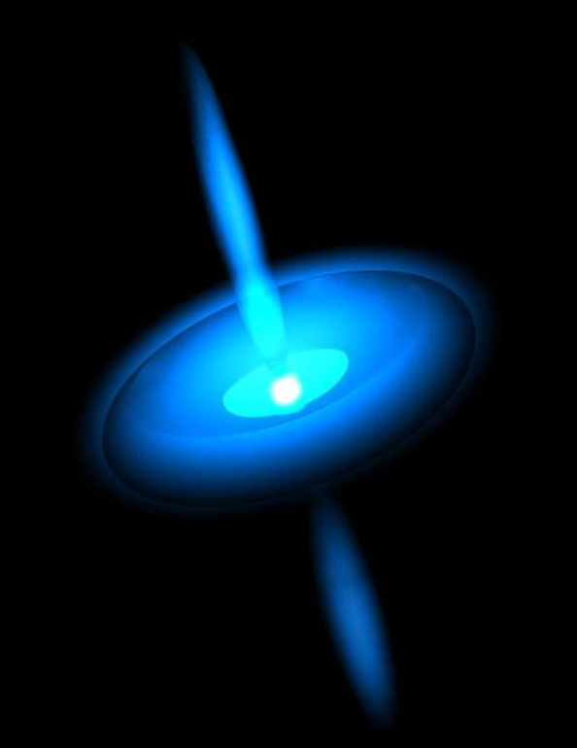
Understanding Pulsars
Presentation of Summer Internship at VATLY
Prasanna Deshapriya
M1 Space Applications (2013 Intake)
USTH

Slide 2


Contents
What are they ?
Discovery of the 1st Pulsar
Properties of Pulsars
Pulsar Physics
P-$\dot{\text{P}}$ Diagram
Millisecond Pulsars as Laboratories
Pulse Profile
Bootstrapping Pulsar Observation
Pulsar Tools & Data Reduction
Galactic Surveys with FAST
Conclusion & Prospects

Slide 3
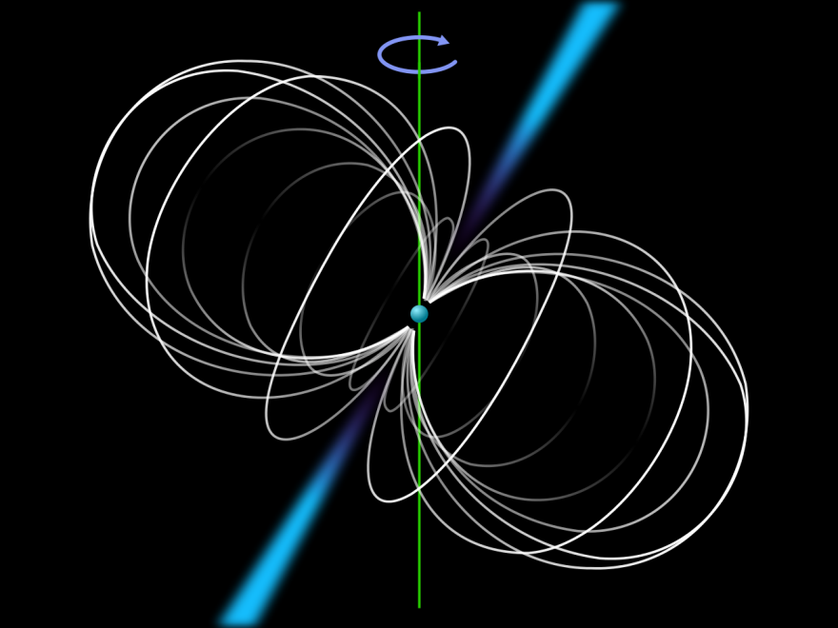
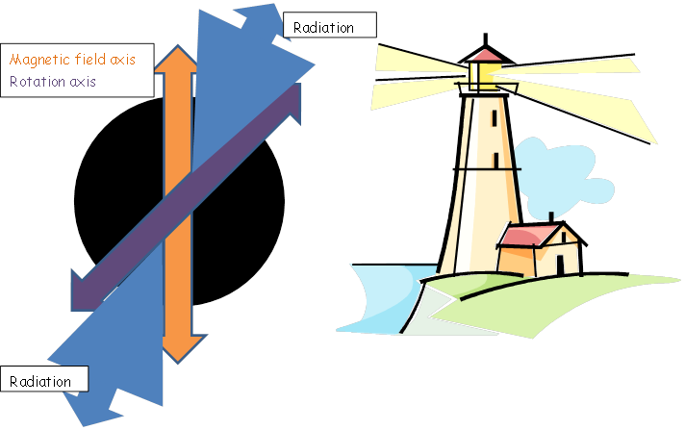
What are they?
Lighthouse effect
Pulsar – Portmanteau for a pulsating star
A highly magnetized, rotating neutron star that emits a beam of electromagnetic radiation

Slide 4

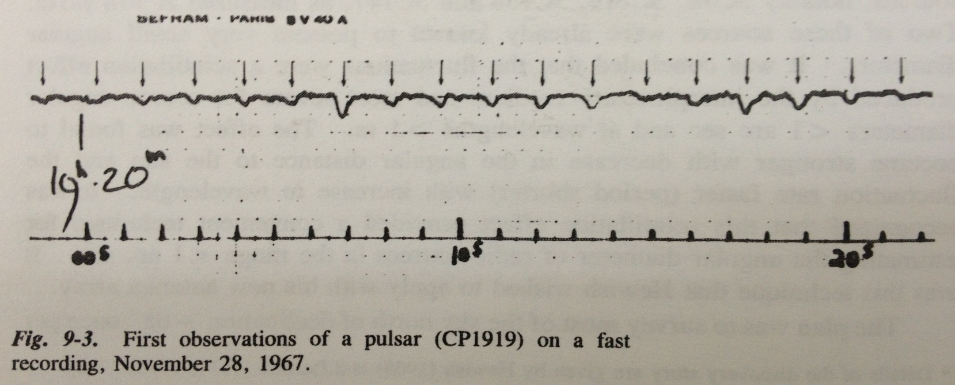
Discovery of the 1st Pulsar
Jocelyn Bell and Antony Hewish discovered a periodic extraterrestrial signal that re-occurs every day at:
RA 19:19:36
DEC +21:47:16

Slide 5
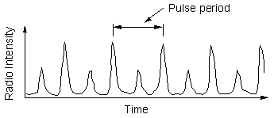
Properties of Pulsars
If the surface temperature exceeds 10⁶ K (as in the case of a young pulsar , the surface should be fluid as opposed to the solid phase observed in cooler neutron stars (temperature <10⁶ K).
Almost black holes (R ~ 10km, M~ 1.4 M☉)
Objects of extreme matter: (Interesting EoS)
B ~ = 4.4 x 10⁹ T
E ~ 10¹² V
High-temperature super-fluid superconductor!
Originates from (usually Type II) supernova explosions:
8 M☉ <M< (40–50) M☉
Fast Rotation
Period
8500 ms
1.4 ms
PSR J1748-2446ad
PSR J2144-3933
33 ms – Crab Pulsar

Slide 6
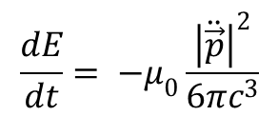
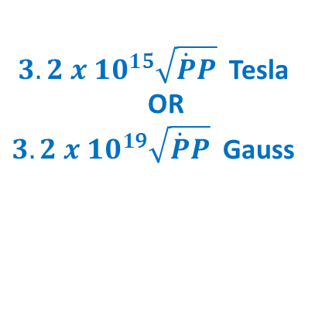

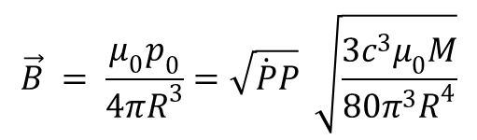


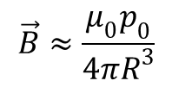

Pulsar Physics
Magnetic Filed ($\vec{B}$)
A pulsar is a spinning magnet
(A magnetic dipole)
Magnetic dipole radiation (E)
$$\vec{p}= \vec{p_{0}}\sin\left(ωt\right)$$
$$\frac{dE}{dt}= −μ_{0}\frac{{\left|\ddot{\vec{p}}\right|}^{2}}{6πc^{3}}$$
$$\vec{B}≈\frac{μ_{0}p_{0}}{4πR^{3}}$$
$$\frac{{dE}_{rot}}{dt}=Iω\dot{ω}$$
$$\frac{dE}{dt}= −μ_{0}\frac{ω^{4}{p_{0}}^{2}}{6πc^{3}}$$
$$\vec{B} = \frac{μ_{0}p_{0}}{4πR^{3}}=\sqrt{\dot{P}P} \sqrt{\frac{3c^{3}μ_{0}M}{80π^{3}R^{4}}}$$
$3.2 {x 10}^{15}\sqrt{\dot{P}P}$ Tesla
OR
$3.2 {x 10}^{19}\sqrt{\dot{P}P}$ Gauss

Slide 7
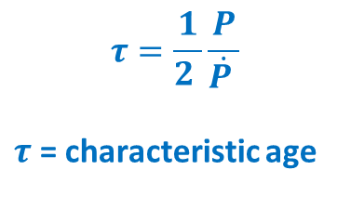
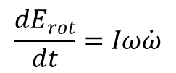
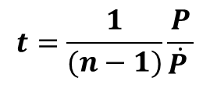
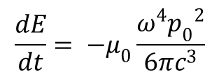
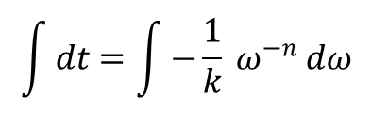

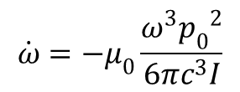
Pulsar Physics
Age of a Pulsar
$$\frac{dE}{dt}= −μ_{0}\frac{ω^{4}{p_{0}}^{2}}{6πc^{3}}$$
$$\frac{{dE}_{rot}}{dt}=Iω\dot{ω}$$
$$\dot{ω}=−μ_{0}\frac{ω^{3}{p_{0}}^{2}}{6πc^{3}I}$$
n = 3
$$\int{dt}=\int{−}\frac{1}{k} ω^{−n} dω$$
$$\dot{ω}=−kω^{n}$$
$$τ=\frac{1}{2 }\frac{P}{\dot{P }}$$
$τ$ = characteristic age
$$t=\frac{1}{(n−1)}\frac{P}{\dot{P }}$$

Slide 8
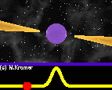
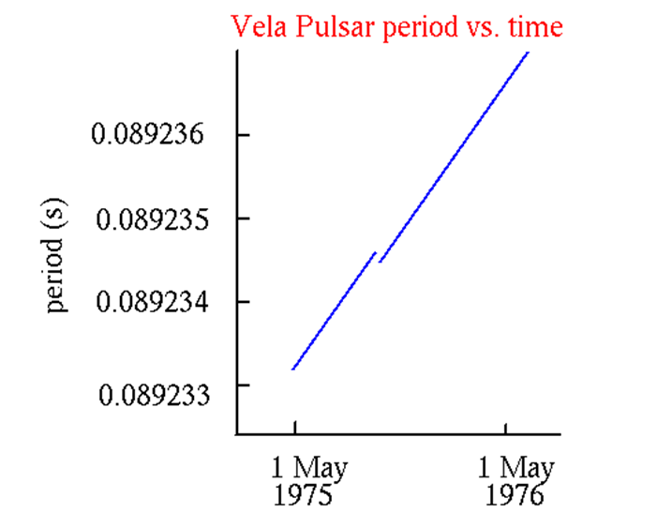
Pulsars Emit Radiation
Energy should come in within
From Rotation
As a result, pulsars slow down/ Their period increases

Slide 9
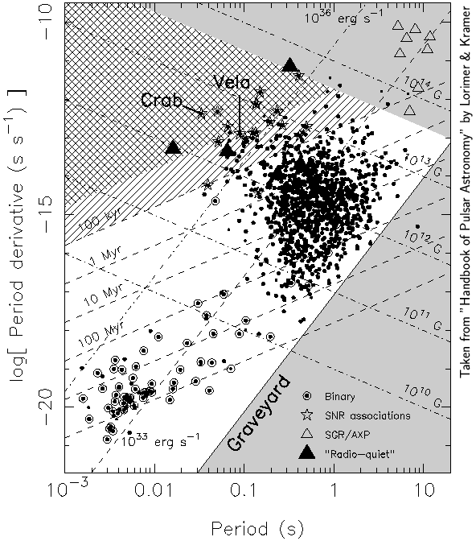



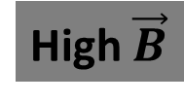



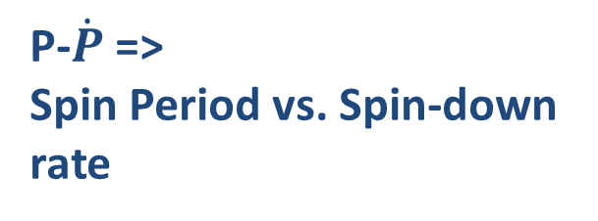

P-$\dot{\text{P}}$ Diagram
$\vec{B}$-> Magnetic Field Strength
High $\vec{B}$
“H-R diagram” of
Pulsar Astronomy
Young
Young Pulsars:
Fast Spin Rate
High $\vec{B}$
Magnetars
Neutron stars with extreme $\vec{B}$
~10¹⁴ Gauss
~1000 x Average pulsars
Powered by the decay of $\vec{B}$field.
NOT by rotation
Millisecond Pulsars (MSPs)
Fast rotation
Very old
Low $\vec{B}$
Created in a binary system
Stable spin
Good for physics tests
H-R =>
Temp vs. Luminosity
Spin-down rate
Young pulsars move down and right as they age, while loosing the rotation energy (It is assumed that $\vec{B}$ remains constant during this process)
P-$\dot{P}$=>
Spin Period vs. Spin-down rate
As they keep moving further right in the diagram, they keep loosing further energy, thus slowing down drastically. Finally there is not enough electric field to generate the emission and the pulses become absent.
Average lifetime of such normal pulsars : 10-100 Myears.
(Milky-way galaxy is 5 Byears old.)
Old
Low $\vec{B}$
Recycle

Slide 10
Millisecond Pulsars as Labs
Millisecond pulsars are very precise objects
They are very accurate clocks
The ‘best’ pulsars correspond to a precision of about one microsecond over 30 years:
Hence, they can compete with good atomic clocks.
Ex: PSR J2145-0750
At 14:15h 09th September 2014 (Hanoi Local time)
P = 16.05242392429388800 ms
±0.00000000000000003 ms

Slide 11
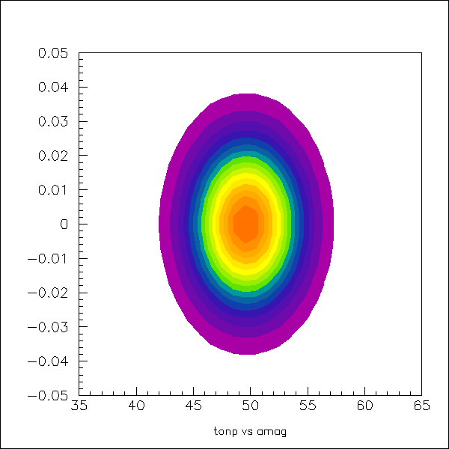
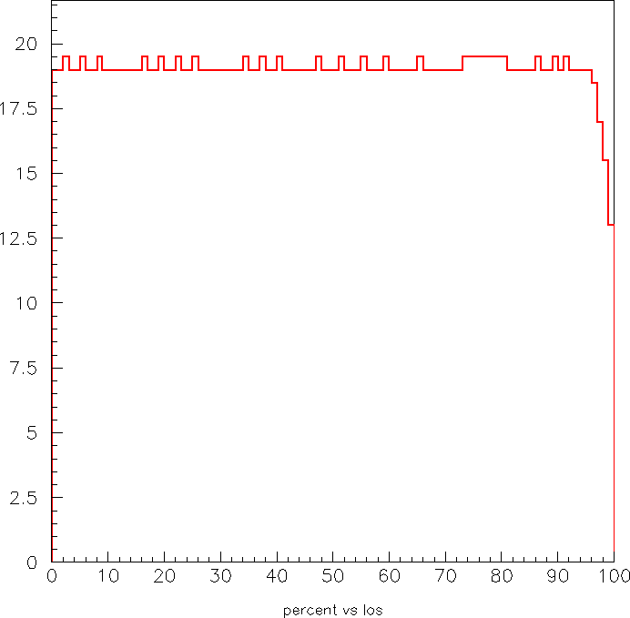
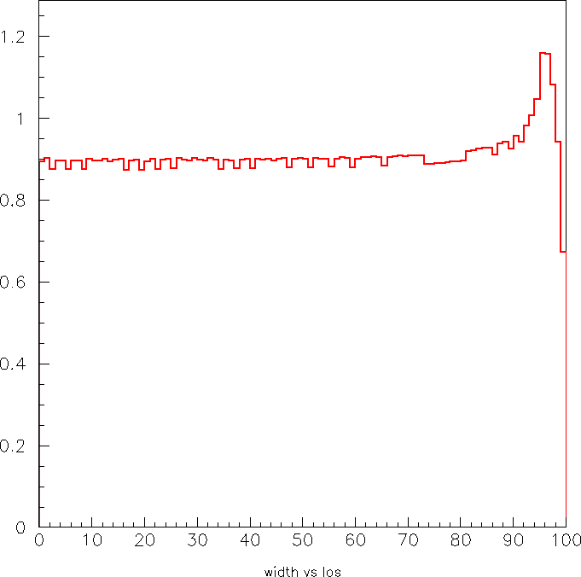
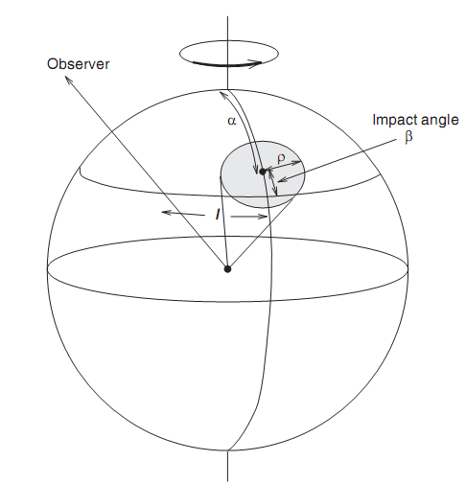


Pulse Profile
Z
$$\vec{mag}$$
α
$$\vec{los}$$
Radiation beam intensity
ω
O
X
Y
Pulsar is seen as soon as ω<3ρ
The probability to see the pulsar, Q, as a function of i_{los}
The pulse width as a function of i_{los}.

Slide 12
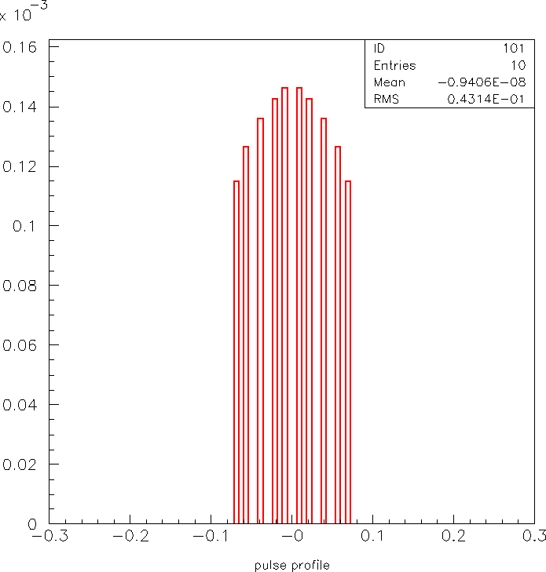
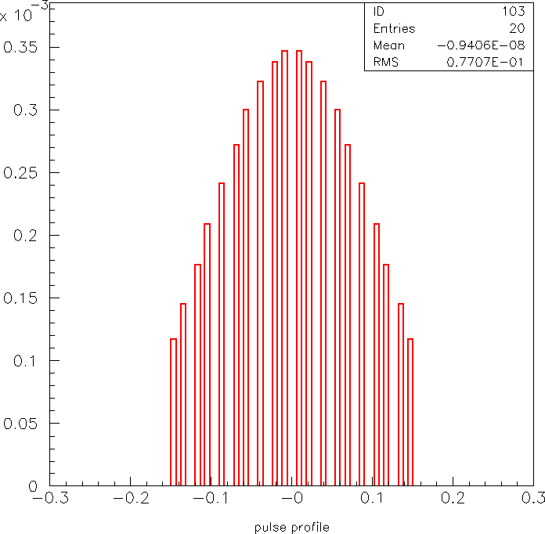
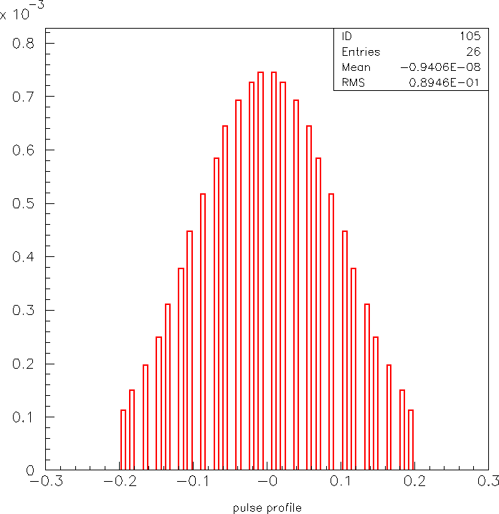
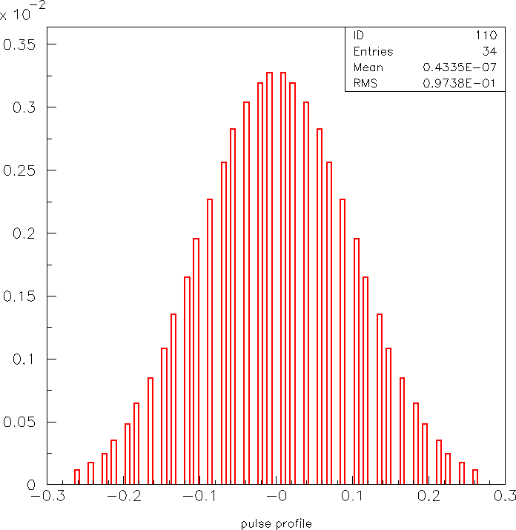
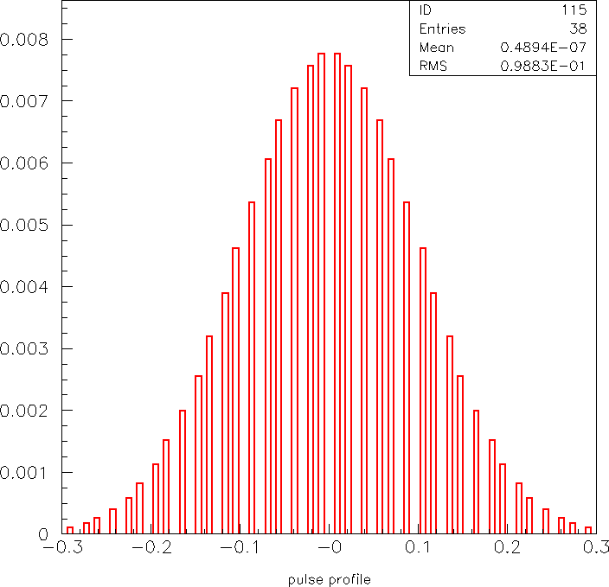

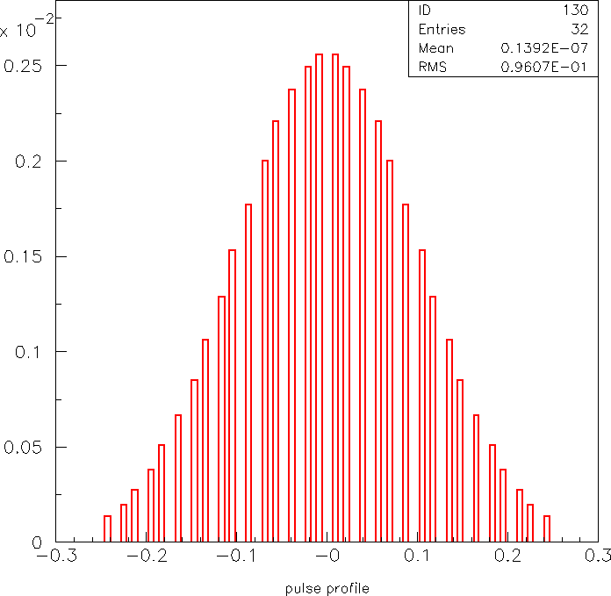
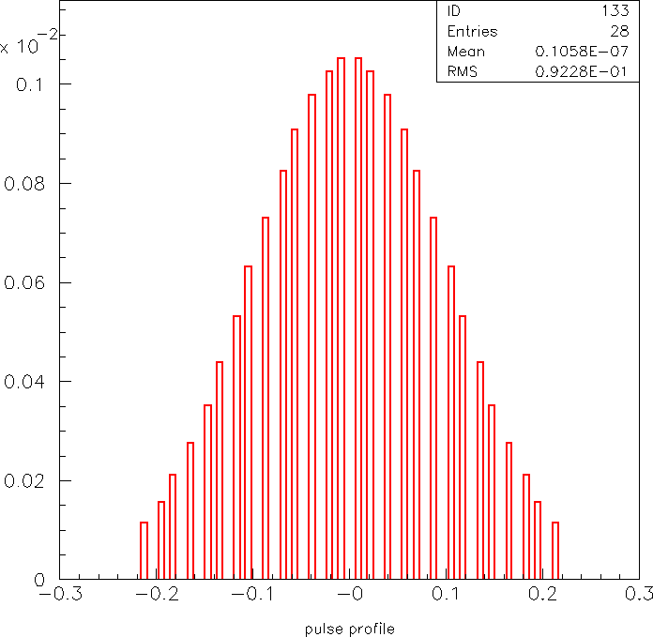
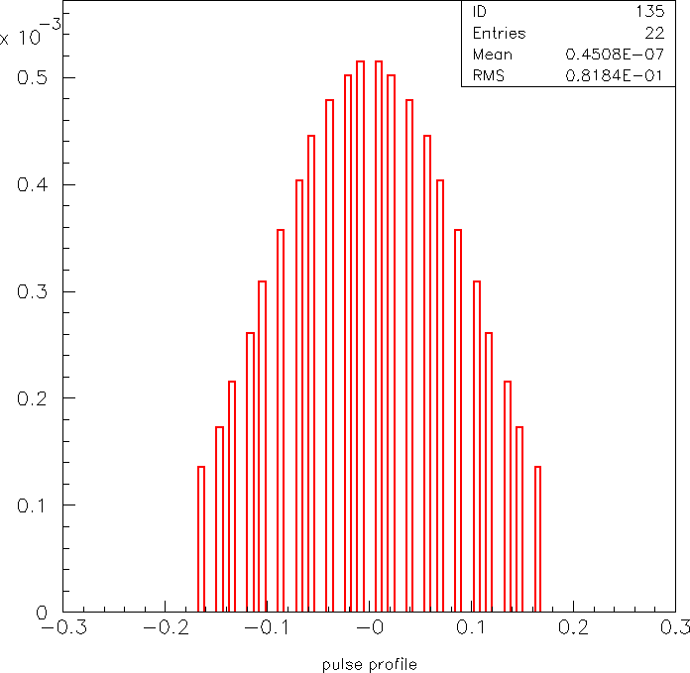
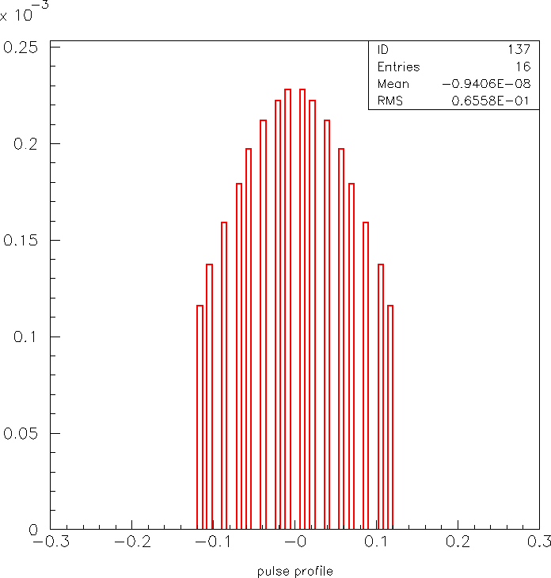

Variation of pulse profile with the impact parameter. From left to right, top to bottom: $β$= 0.29, 0.26, 0.23, 0.15, 0.01, −0.01, −0.16, −0.21, −0.24, −0.27 and −0.29 radians.

Slide 13
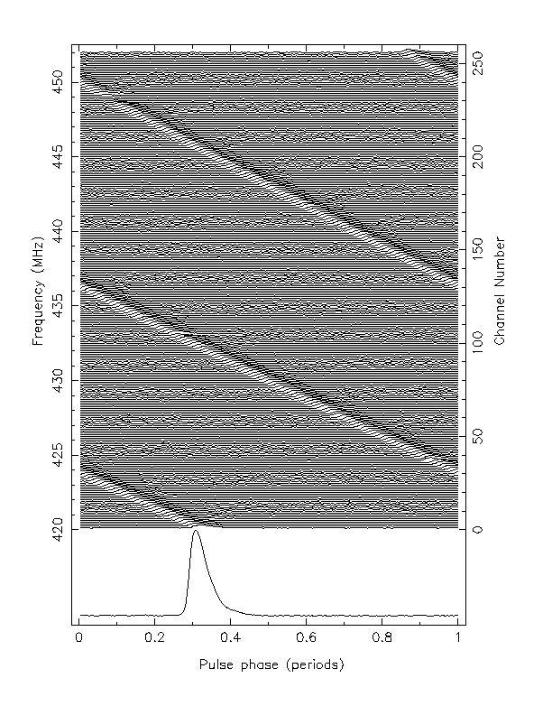
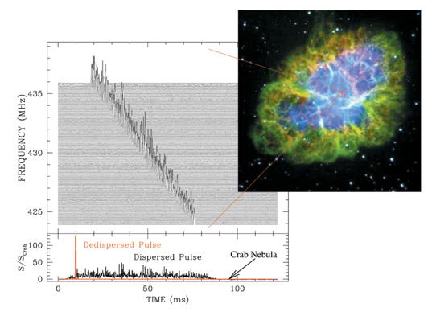
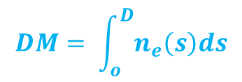
Bootstrapping Pulsar Observation
Dispersion Measure
$$DM= \int_{o}^{D}{n_{e}\left(s\right)ds}$$

Slide 14
Bootstrapping Pulsar Observation
De-dispersion
uncorrected
corrected
It is necessary to de-disperse the signal to observe the pulsar

Slide 15
Challenges & Solutions
Unknowns | What is done
Position in the sky | Scan the entire sky or a region of interest (SNR)
Dispersion Measure | De-disperse for range of trial values
Pulse Period | Use Fourier Transform to search for spin frequency
Pulse Width | Harmonic summing of Fourier spectrum

Slide 16
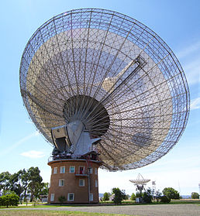
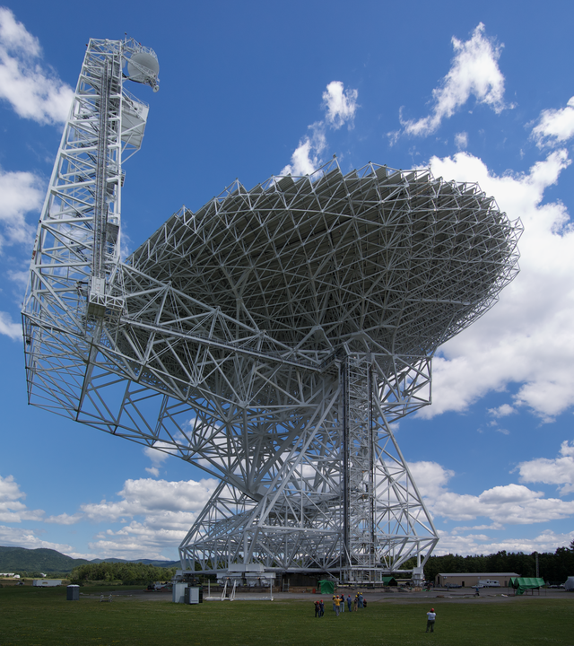
Pulsar Tools for Data Reduction
Presto
Tempo
Tempo2
Psrchive
Psrsoft
Sigproc
Psrpop
Parkes Telescope
Green Bank Telescope

Slide 17
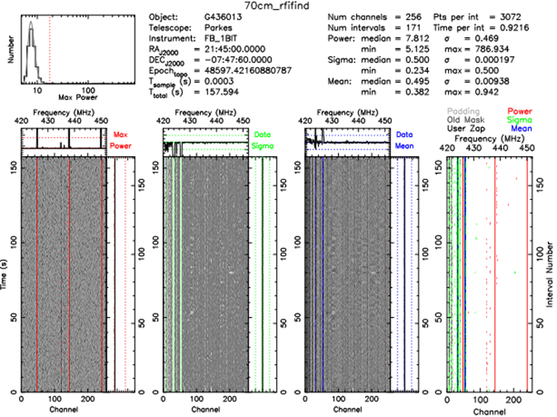

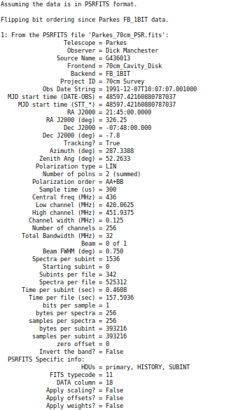
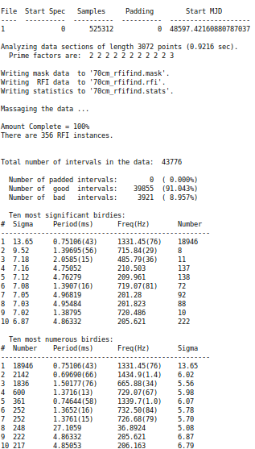

Slide 18
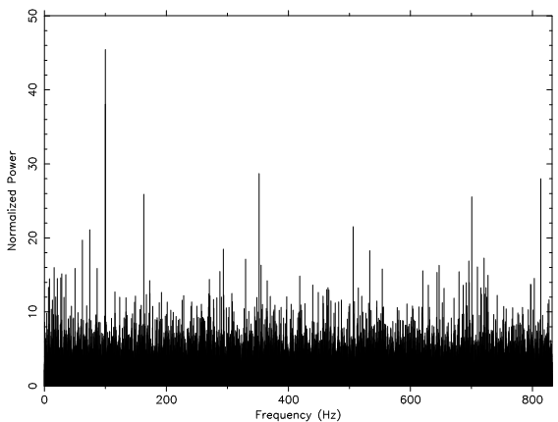
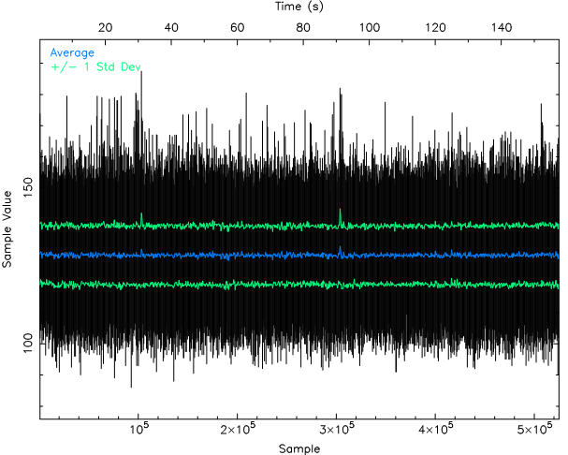
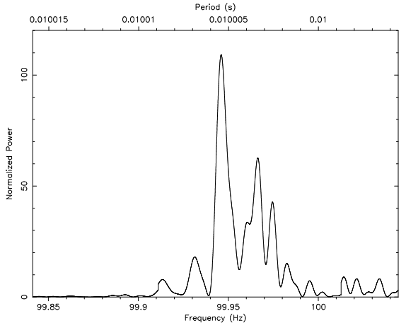



Time Series and Power Spectrum of the signal
RFIs to remove
FFT

Slide 19

De-dispersion Plan

Slide 20

Choosing the best candidate/ Sifting
Exploring the ASCII data file to find the highest Gaussian peak which is a function of DM & SNR
We select DM = 9.40 pc/cm³ with SNR = 54.96

Slide 21


Pulsar identified as J2145-0750; an MSP

Slide 22


Galactic Survey with FAST
A 3-D Model
Construction as of June 2014:
Due functional by 2018
Located in Guizhou Province, China ; 600 Km North of Hanoi

Slide 23


Simulations with Psrpop
The number of pulsars detectable by FAST as a function of observation time per pointing position.
The number of pulsars detectable by FAST as a function of centre frequency

Slide 24



Varieties + Stats
Radio Pulsars ~ 2000
Binary Pulsars ~ 150
(Companion: Neutron Star/ Planet/ White Dwarfs)
1 Double Pulsar
(PSR J0737-3039A/B , 22.7ms + 2.77s)
Discovered at Parkes Observatory, Australia - 2003

Slide 25
Conclusion & Prospects
This summer internship at VATLY has been extremely interesting.
Pulsars are interesting astrophysical objects (esp. MSPs)
A lot of fundamental science can be produced.
In future, I’m interested in further exploring about following:
  Pulsar Timing
  Tests of general relativity
  Gravitational waves detection
  Shapiro-delay

Slide 26
Thank you !

